Slide 1
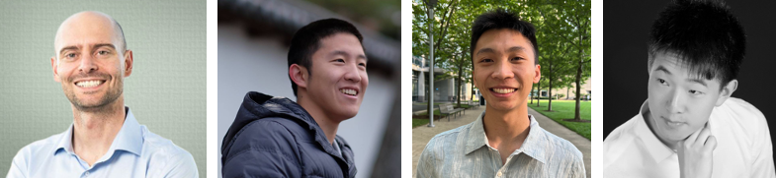
CS294-158 Deep Unsupervised Learning
Lecture 3 Likelihood Models: Flow Models
Pieter Abbeel, Wilson Yan, Kevin Frans, Philipp Wu

Slide 2
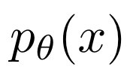
Overview
What do we want from a generative model?
Good fit to the training data (really, the underlying distribution!)
For new x, ability to evaluate
Ability to sample from
A latent representation / embedding space that’s meaningful
Recall L2 Autoregressive Models?
Check many boxes except
Sampling is serial (hence slow)
Lacks latent representation / embedding space
Limited to discrete data (at least in terms of where experimental success has been)
Flow Models will check all boxes (but performance not as good as other models…)

Slide 3

Flow Models
Goal: Fit a density model with continuous
What do we want from this model?
Good fit to the training data (really, the underlying distribution!)
For new x, ability to evaluate
Ability to sample from
A latent representation / embedding space that’s meaningful

Slide 4
Outline
Foundations of Flows (1-D)
2-D Flows
N-D Flows
Dequantization

Slide 5
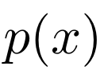
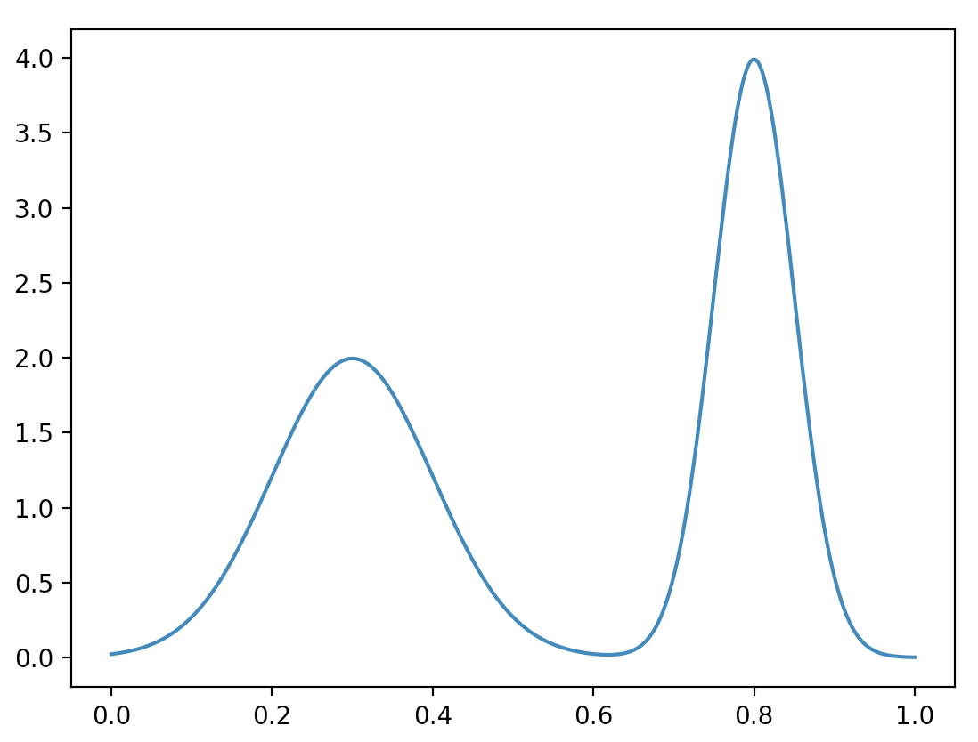
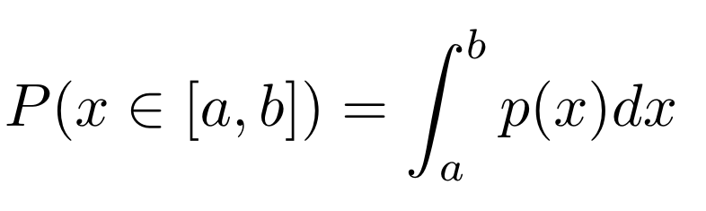

Quick Refresher: Probability Density Models

Slide 6
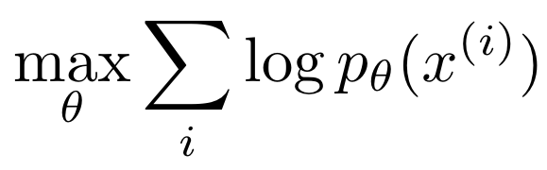
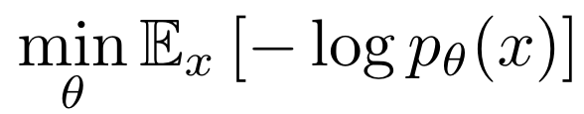
How to fit a density model?
Continuous data
0.22159854, 0.84525919, 0.09121633, 0.364252 , 0.30738086,
0.32240615, 0.24371194, 0.22400792, 0.39181847, 0.16407012,
0.84685229, 0.15944969, 0.79142357, 0.6505366 , 0.33123603,
0.81409325, 0.74042126, 0.67950372, 0.74073271, 0.37091554,
0.83476616, 0.38346571, 0.33561352, 0.74100048, 0.32061713,
0.09172335, 0.39037131, 0.80496586, 0.80301971, 0.32048452,
0.79428266, 0.6961708 , 0.20183965, 0.82621227, 0.367292 ,
0.76095756, 0.10125199, 0.41495427, 0.85999877, 0.23004346,
0.28881973, 0.41211802, 0.24764836, 0.72743029, 0.20749136,
0.29877091, 0.75781455, 0.29219608, 0.79681589, 0.86823823,
0.29936483, 0.02948181, 0.78528968, 0.84015573, 0.40391632,
0.77816356, 0.75039186, 0.84709016, 0.76950307, 0.29772759,
0.41163966, 0.24862007, 0.34249207, 0.74363912, 0.38303383, …
Maximum Likelihood:
Equivalently:

Slide 7
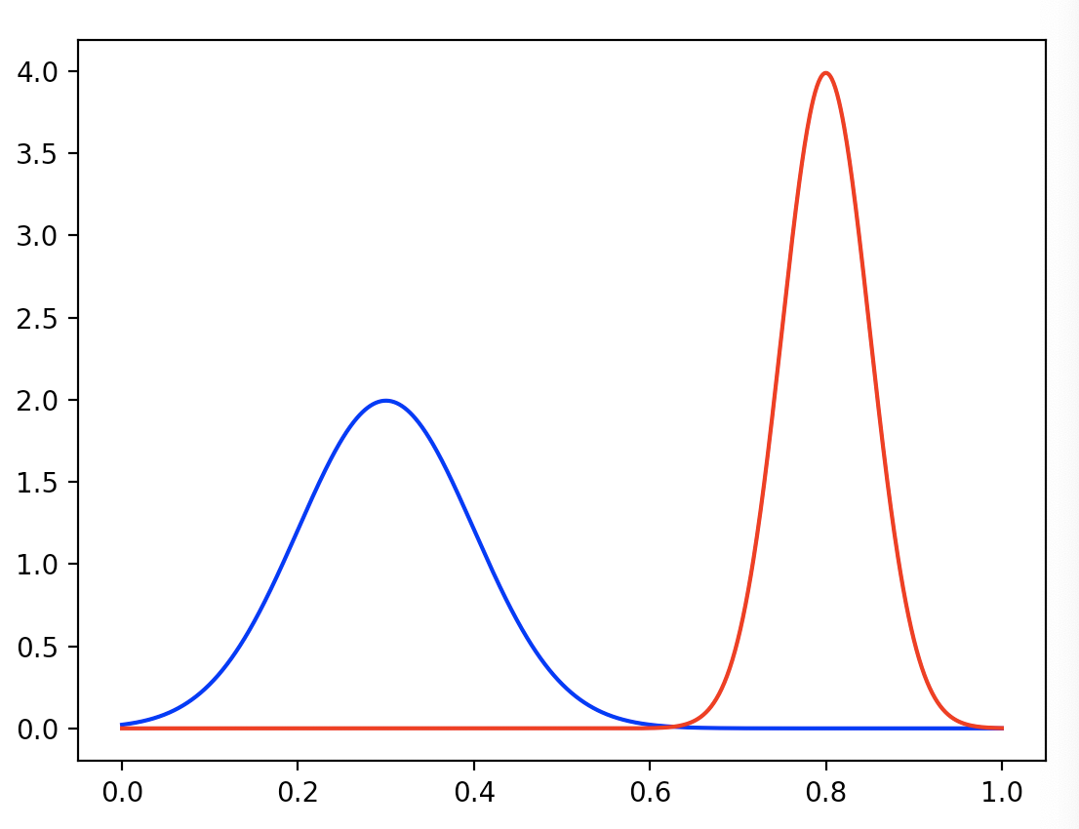
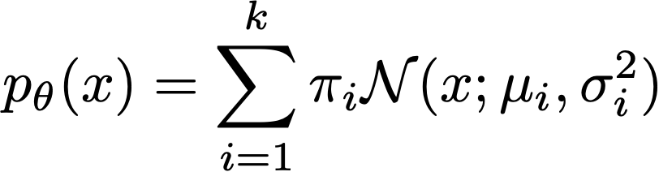
Example Density Model: Mixtures of Gaussians
Parameters: means and variances of components, mixture weights
Notes:
p_\theta(x) = \sum_{i=1}^k \pi_i \mathcal{N}(x; \mu_i, \sigma_i^2)
\arg\min_\theta \mathbb{E}_x [ -\log p_\theta (x) ]

Slide 8
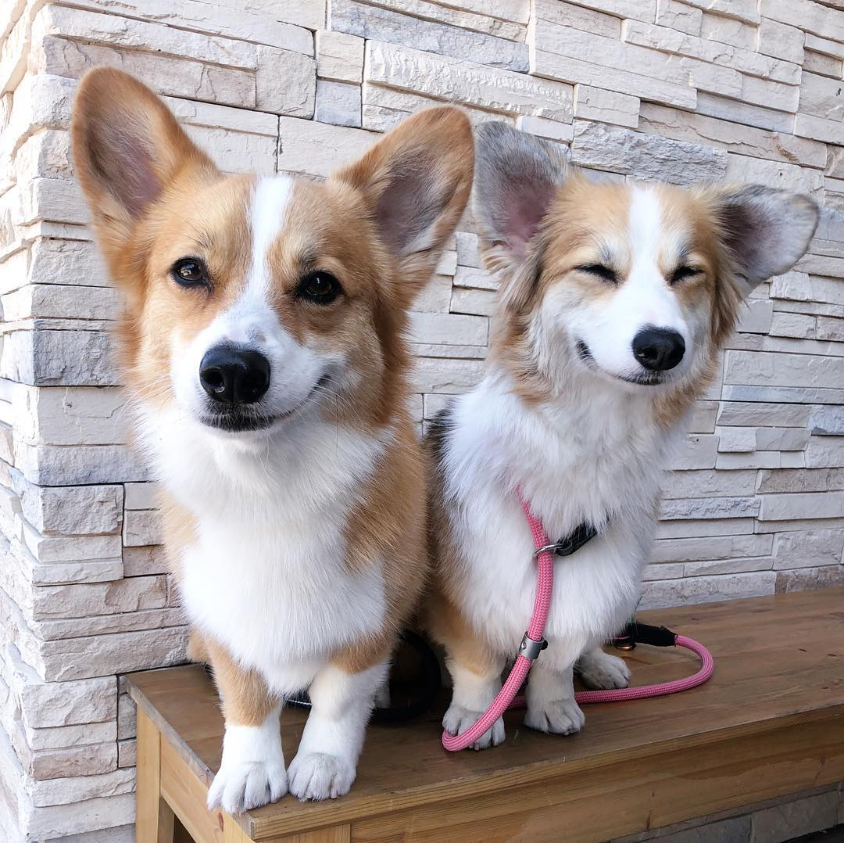
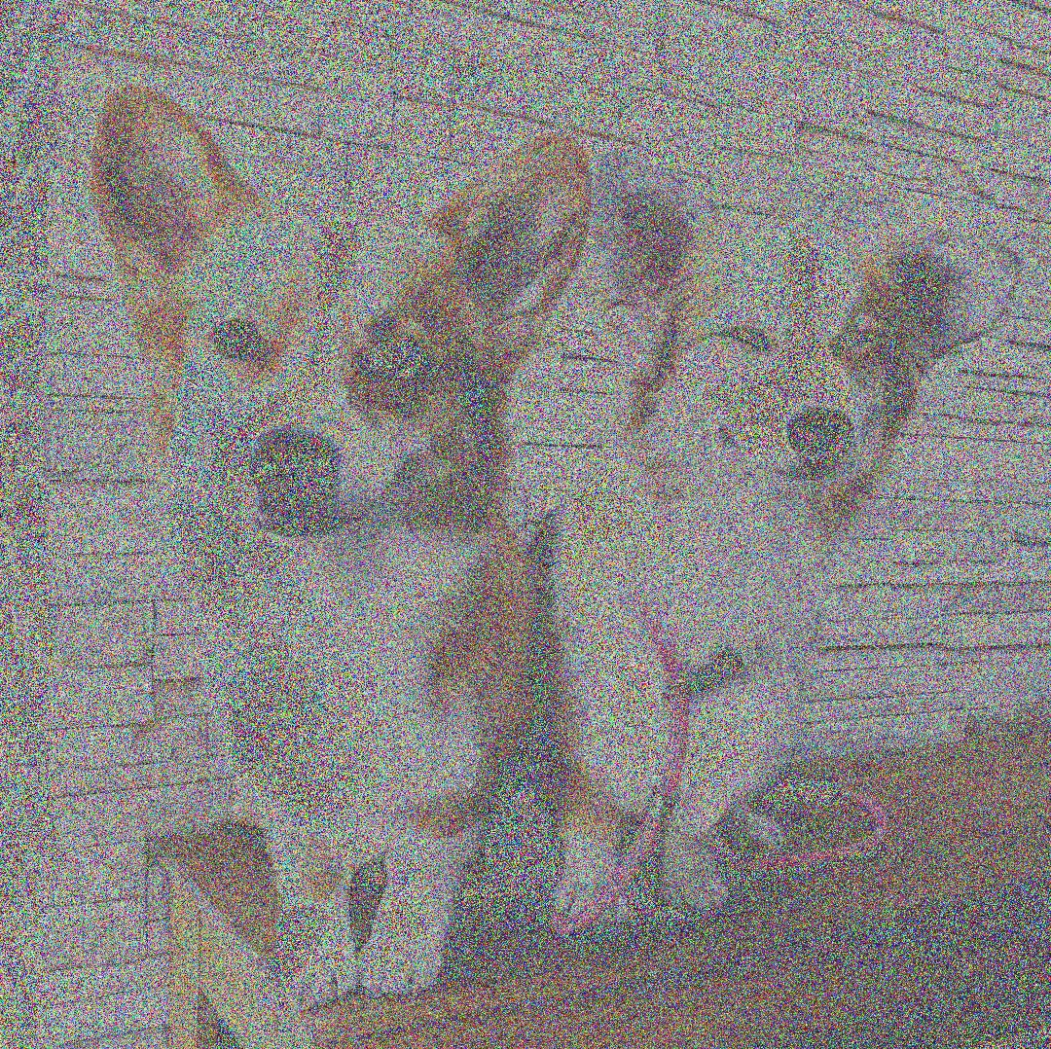
Aside on Mixtures of Gaussians
Do mixtures of Gaussians work for high-dimensional data?
Not really. The sampling process is:
Pick a cluster center
Add Gaussian noise
Imagine this for modeling natural images! The only way a realistic image can be generated is if it is a cluster center, i.e. if it is already stored directly in the parameters.

Slide 9

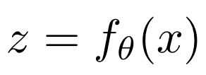
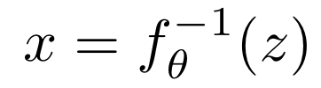
Flow Models: Invertible transform from data x to embedding z
Original data space, complex distribution to model
Embedding space, we enforce a simpler distribution
x
...
Note: VAE has very similar diagram, but learns both directions rather than imposing invertibility (see L4)

Slide 10
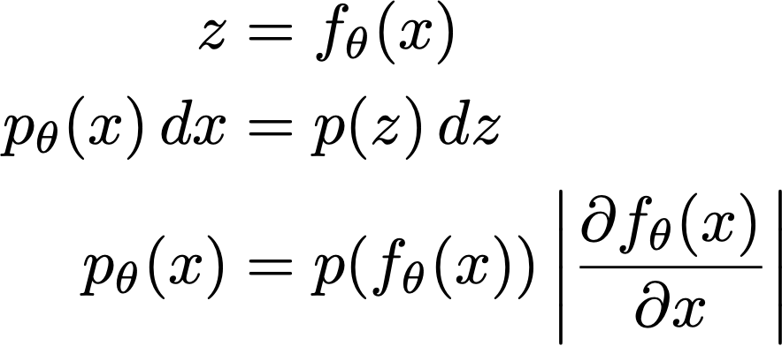

Change of Variables Formula
Note: for this simple formula to work, it requires invertible & differentiable
Notes:
Suppose z ~ Uniform([0, 1]), p(z) = 1; and x = 2z
What is the probability density for x?
It is p(x) = ½ , i.e. Uniform([0, 2]).
Notice that the density changed, because the x-axis was stretched. This ensures that probability is conserved across the flow z -> 2z.

Slide 11
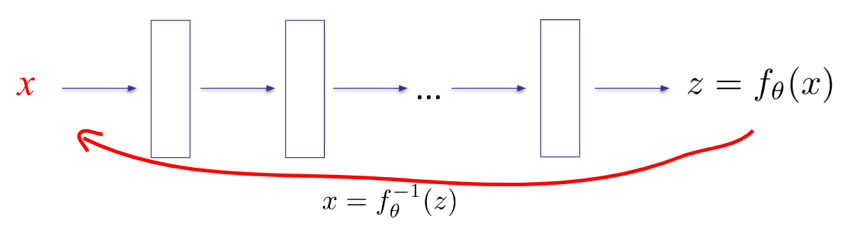
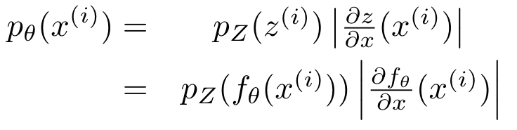
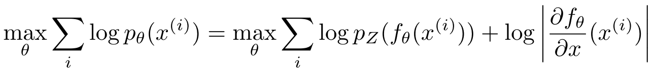

Flow Models: Training
Assuming we have an expression for ,
this can be optimized with Stochastic Gradient Descent

Slide 12
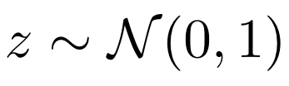

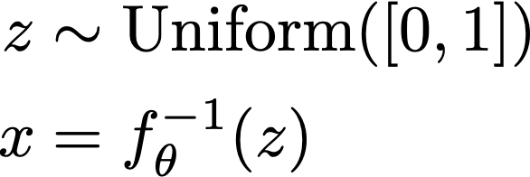
Flow Models: Examples
Two choices to make:
Invertible function class
Embedding space density
I.e., in 1-D this is any monotonically increasing (or decreasing) function
Ideally an easy distribution to sample from
E.g.:
- a x + b (for positive a) - polynomials with positive coefficients and only odd powers - exp (theta x) - sigmoid (a x + b) - cumulative density functions, e.g. CDF of mixture of Gaussians or weighted sum of logistics - composition of flows = flow
E.g.:
“normalizing flow”
mixture of Gaussians
-> make sure maps to [0,1]

Slide 13
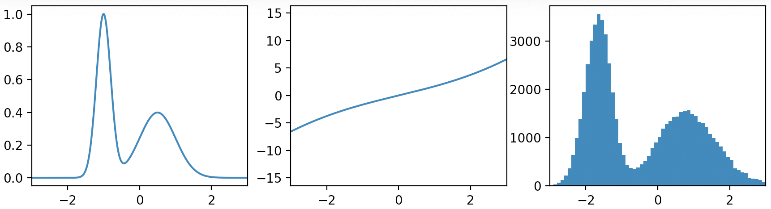
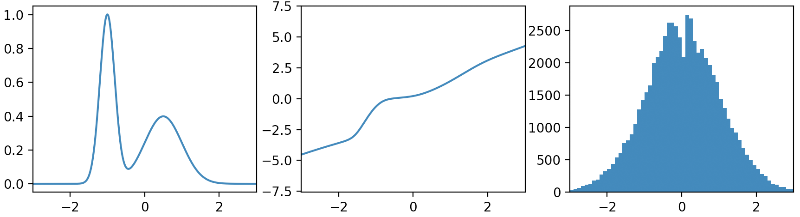
Example: Flow to Gaussian z
Before training
After training
True distribution of x
Flow x → z
Empirical distribution of z
Notes:
import matplotlib.pyplot as plt
import numpy as np
import scipy.stats
import tensorflow as tf
from tqdm import trange
def inverse_sigmoid(x):
return -tf.log(tf.reciprocal(x) - 1.)
class Model:
def __init__(self, bs, hdim=128):
self.x = tf.placeholder(tf.float32, [bs]) # input
self.mu = tf.get_variable('a', shape=[1, hdim], initializer=tf.random_normal_initializer(0, 0.01))
self.logscale = tf.get_variable('b', shape=[1, hdim], initializer=tf.random_normal_initializer(0, 0.01))
self.logits = tf.get_variable('w', shape=[1, hdim], initializer=tf.random_normal_initializer(0, 0.01))
weights = tf.nn.softmax(self.logits, axis=1)
scale = tf.exp(self.logscale)
mu = tf.tile(self.mu, [bs, 1])
scale = tf.tile(scale, [bs, 1])
cdfs = tf.distributions.Normal(mu, scale).cdf(self.x[:, None])
assert cdfs.shape == [bs, hdim]
self.z = inverse_sigmoid(tf.reduce_sum(cdfs * weights, axis=1))
self.dzdx, = tf.gradients(self.z, self.x)
assert self.dzdx.shape == self.z.shape
assert self.z.shape == [bs]
self.bpd = -tf.reduce_mean(tf.distributions.Normal(0., 1.).log_prob(self.z) + tf.log(self.dzdx)) / np.log(2)
self.train_op = tf.train.AdamOptimizer(1e-3).minimize(self.bpd)
def sample_data(count):
a = -1 + 0.2 * np.random.randn(count)
b = 0.5 + 0.5 * np.random.randn(count)
mask = np.random.rand(count) < 0.5
return a * mask + b * (1 - mask)
def data_pdf(xs):
return 0.5 * scipy.stats.norm.pdf(xs, -1, 0.2) + 0.5 * scipy.stats.norm.pdf(xs, 0.5, 0.5)
def main(seed=0):
np.random.seed(seed)
tf.set_random_seed(seed)
train_bs = 64
model = Model(bs=train_bs)
with tf.Session() as sess:
sess.run(tf.global_variables_initializer())
fig, axes = plt.subplots(1, 3, sharex=True)
# train
losses = []
for _ in trange(10000):
bpd, _ = sess.run([model.bpd, model.train_op], {model.x: sample_data(train_bs)})
losses.append(bpd)
# plot data distribution
xs = np.linspace(-5, 5, train_bs * 500)
axes[0].plot(xs, data_pdf(xs))
# plot the flow
ys = np.concatenate([
sess.run(model.z, {model.x: xs[i:i + train_bs]})
for i in range(0, len(xs), train_bs)
])
axes[1].plot(xs, ys)
# plot z distribution
plot_zs = []
while len(plot_zs) < 1000:
plot_zs.append(sess.run(model.z, {model.x: sample_data(train_bs)}))
axes[2].hist(np.concatenate(plot_zs), bins=100, range=[-5, 5])
for ax in axes:
ax.set_xlim(-3, 3)
plt.show()
if __name__ == '__main__':
main()

Slide 14
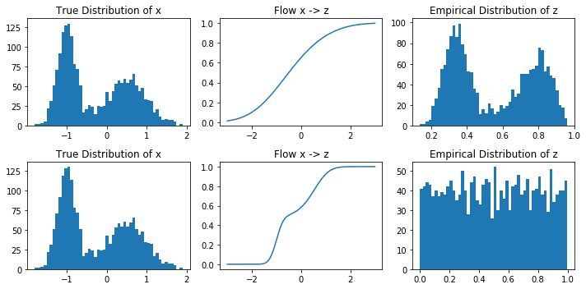
Example: Flow to Uniform z
Before training
After training
True distribution of x
Flow x → z
Empirical distribution of z
Notes:
import matplotlib.pyplot as plt
import numpy as np
import scipy.stats
import tensorflow as tf
from tqdm import trange
def inverse_sigmoid(x):
return -tf.log(tf.reciprocal(x) - 1.)
class Model:
def __init__(self, bs, hdim=128):
self.x = tf.placeholder(tf.float32, [bs]) # input
self.mu = tf.get_variable('a', shape=[1, hdim], initializer=tf.random_normal_initializer(0, 0.01))
self.logscale = tf.get_variable('b', shape=[1, hdim], initializer=tf.random_normal_initializer(0, 0.01))
self.logits = tf.get_variable('w', shape=[1, hdim], initializer=tf.random_normal_initializer(0, 0.01))
weights = tf.nn.softmax(self.logits, axis=1)
scale = tf.exp(self.logscale)
mu = tf.tile(self.mu, [bs, 1])
scale = tf.tile(scale, [bs, 1])
cdfs = tf.distributions.Normal(mu, scale).cdf(self.x[:, None])
assert cdfs.shape == [bs, hdim]
self.z = inverse_sigmoid(tf.reduce_sum(cdfs * weights, axis=1))
self.dzdx, = tf.gradients(self.z, self.x)
assert self.dzdx.shape == self.z.shape
assert self.z.shape == [bs]
self.bpd = -tf.reduce_mean(tf.distributions.Normal(0., 1.).log_prob(self.z) + tf.log(self.dzdx)) / np.log(2)
self.train_op = tf.train.AdamOptimizer(1e-3).minimize(self.bpd)
def sample_data(count):
a = -1 + 0.2 * np.random.randn(count)
b = 0.5 + 0.5 * np.random.randn(count)
mask = np.random.rand(count) < 0.5
return a * mask + b * (1 - mask)
def data_pdf(xs):
return 0.5 * scipy.stats.norm.pdf(xs, -1, 0.2) + 0.5 * scipy.stats.norm.pdf(xs, 0.5, 0.5)
def main(seed=0):
np.random.seed(seed)
tf.set_random_seed(seed)
train_bs = 64
model = Model(bs=train_bs)
with tf.Session() as sess:
sess.run(tf.global_variables_initializer())
fig, axes = plt.subplots(1, 3, sharex=True)
# train
losses = []
for _ in trange(10000):
bpd, _ = sess.run([model.bpd, model.train_op], {model.x: sample_data(train_bs)})
losses.append(bpd)
# plot data distribution
xs = np.linspace(-5, 5, train_bs * 500)
axes[0].plot(xs, data_pdf(xs))
# plot the flow
ys = np.concatenate([
sess.run(model.z, {model.x: xs[i:i + train_bs]})
for i in range(0, len(xs), train_bs)
])
axes[1].plot(xs, ys)
# plot z distribution
plot_zs = []
while len(plot_zs) < 1000:
plot_zs.append(sess.run(model.z, {model.x: sample_data(train_bs)}))
axes[2].hist(np.concatenate(plot_zs), bins=100, range=[-5, 5])
for ax in axes:
ax.set_xlim(-3, 3)
plt.show()
if __name__ == '__main__':
main()

Slide 15
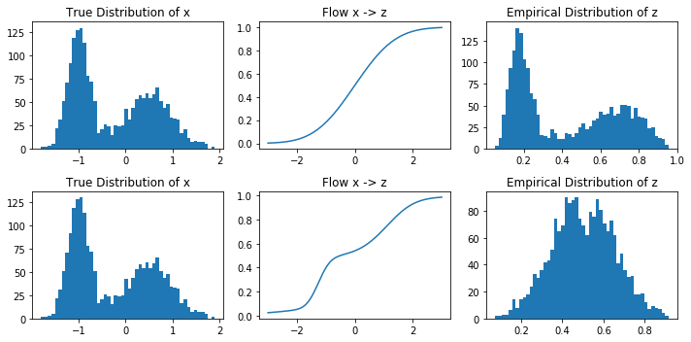
Example: Flow to Beta(5,5) z
Before training
After training
True distribution of x
Flow x → z
Empirical distribution of z
Notes:
import matplotlib.pyplot as plt
import numpy as np
import scipy.stats
import tensorflow as tf
from tqdm import trange
def inverse_sigmoid(x):
return -tf.log(tf.reciprocal(x) - 1.)
class Model:
def __init__(self, bs, hdim=128):
self.x = tf.placeholder(tf.float32, [bs]) # input
self.mu = tf.get_variable('a', shape=[1, hdim], initializer=tf.random_normal_initializer(0, 0.01))
self.logscale = tf.get_variable('b', shape=[1, hdim], initializer=tf.random_normal_initializer(0, 0.01))
self.logits = tf.get_variable('w', shape=[1, hdim], initializer=tf.random_normal_initializer(0, 0.01))
weights = tf.nn.softmax(self.logits, axis=1)
scale = tf.exp(self.logscale)
mu = tf.tile(self.mu, [bs, 1])
scale = tf.tile(scale, [bs, 1])
cdfs = tf.distributions.Normal(mu, scale).cdf(self.x[:, None])
assert cdfs.shape == [bs, hdim]
self.z = inverse_sigmoid(tf.reduce_sum(cdfs * weights, axis=1))
self.dzdx, = tf.gradients(self.z, self.x)
assert self.dzdx.shape == self.z.shape
assert self.z.shape == [bs]
self.bpd = -tf.reduce_mean(tf.distributions.Normal(0., 1.).log_prob(self.z) + tf.log(self.dzdx)) / np.log(2)
self.train_op = tf.train.AdamOptimizer(1e-3).minimize(self.bpd)
def sample_data(count):
a = -1 + 0.2 * np.random.randn(count)
b = 0.5 + 0.5 * np.random.randn(count)
mask = np.random.rand(count) < 0.5
return a * mask + b * (1 - mask)
def data_pdf(xs):
return 0.5 * scipy.stats.norm.pdf(xs, -1, 0.2) + 0.5 * scipy.stats.norm.pdf(xs, 0.5, 0.5)
def main(seed=0):
np.random.seed(seed)
tf.set_random_seed(seed)
train_bs = 64
model = Model(bs=train_bs)
with tf.Session() as sess:
sess.run(tf.global_variables_initializer())
fig, axes = plt.subplots(1, 3, sharex=True)
# train
losses = []
for _ in trange(10000):
bpd, _ = sess.run([model.bpd, model.train_op], {model.x: sample_data(train_bs)})
losses.append(bpd)
# plot data distribution
xs = np.linspace(-5, 5, train_bs * 500)
axes[0].plot(xs, data_pdf(xs))
# plot the flow
ys = np.concatenate([
sess.run(model.z, {model.x: xs[i:i + train_bs]})
for i in range(0, len(xs), train_bs)
])
axes[1].plot(xs, ys)
# plot z distribution
plot_zs = []
while len(plot_zs) < 1000:
plot_zs.append(sess.run(model.z, {model.x: sample_data(train_bs)}))
axes[2].hist(np.concatenate(plot_zs), bins=100, range=[-5, 5])
for ax in axes:
ax.set_xlim(-3, 3)
plt.show()
if __name__ == '__main__':
main()

Slide 16
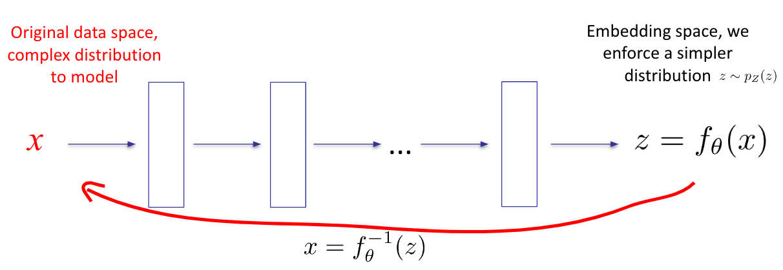
1-D Flow Models Summary
Training:
Inference: evaluate training objective
Sampling: first sample z from then compute

Slide 17
Aside: special case of a CDF and p(z) U[0,1]
E.g. Gaussian CDF, mixture CDF, logit CDF, multiple CDFs

Slide 18
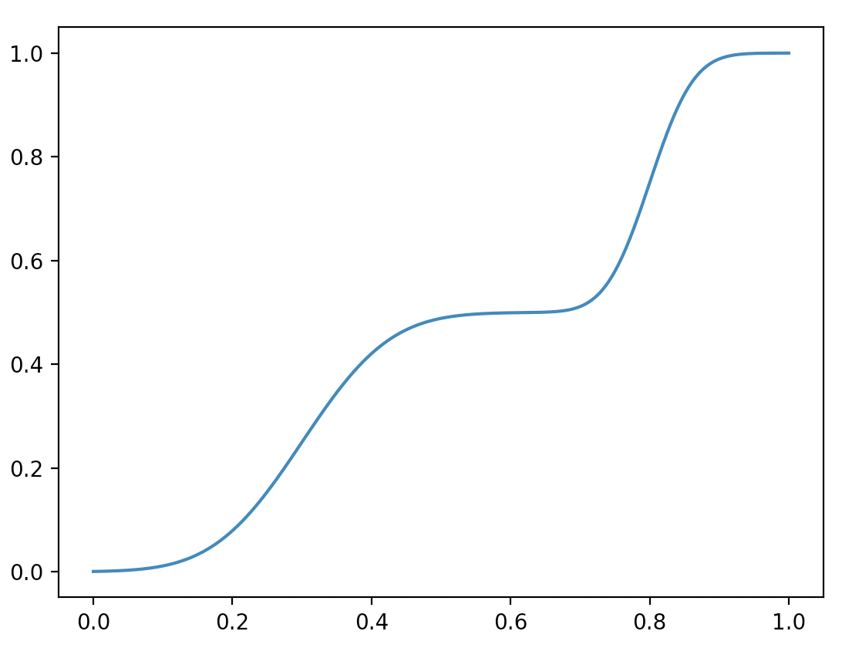
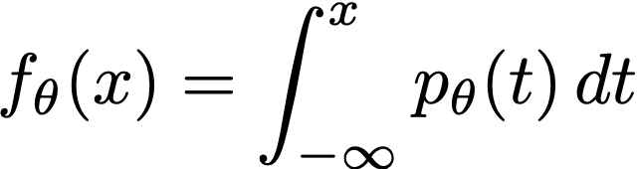

Refresher: Cumulative Density Function (CDF)
Notes:
f_\theta(x) = \int_{-\infty}^x p_\theta(t) \, dt

Slide 19
Sampling via inverse CDF
Sampling from the model:
The CDF is an invertible, differentiable map from data to [0, 1]
Notes:
u &\sim \mathrm{Uniform}([0,1]) \\
x &= f_\theta^{-1}(u)

Slide 20
CDF Flows: special case of a CDF and p(z) U[0,1]
If we use a flow defined as a parameterized CDF, we recover the original objective for fitting the corresponding parameterized PDF.
Notes:
CDF is a flow from x to Uniform([0, 1])
Z = CDF(x)
Log p(x) = log p(z) + log |CDF’(x)|, but log p(z) = 0 and log cdf’(x) = log pdf(x)
So we get log p(x) = log pdf(x)
So why do we care? Because we now know any differentiable invertible transformation is acceptable, don’t need to worry about defining density functions → can leverage broader power of neural nets

Slide 21
CDF Flows: special case of a CDF and p(z) U[0,1]
If we use a flow defined as a parameterized CDF, we recover the original objective for fitting the corresponding parameterized PDF.
this term constant per p(z) uniform
cdf’(x) = pdf(x)
Notes:
CDF is a flow from x to Uniform([0, 1])
Z = CDF(x)
Log p(x) = log p(z) + log |CDF’(x)|, but log p(z) = 0 and log cdf’(x) = log pdf(x)
So we get log p(x) = log pdf(x)
So why do we care? Because we now know any differentiable invertible transformation is acceptable, don’t need to worry about defining density functions → can leverage broader power of neural nets

Slide 22
How general are flows?
Can every (smooth) distribution be represented by a (normalizing) flow? [considering 1-D for now]

Slide 23



How general are flows?
CDF turns any density into uniform
Inverse flow is flow
→ can turn any (smooth) p(x) into any (smooth) p(z)
Notes:
Can turn any density p(x) into any density p(z) by x -> cdfX(x) = u -> inversecdfZ(u) = z

Slide 24
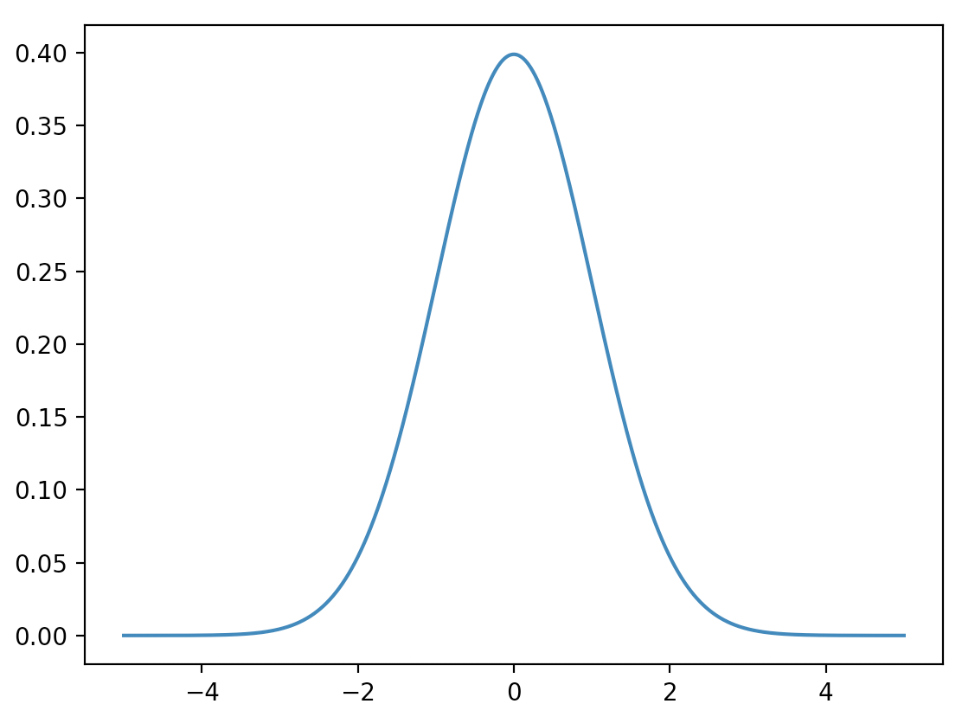
Recap of Flow Models in 1D
Flow: a differentiable, invertible mapping from x (data) to z (noise)
Train so that it turns the data distribution into a base distribution p(z)
Common choices: uniform, standard normal
This way, mapping z ~ p(z) through the flow’s inverse will yield good samples
f (inference)
f⁻¹ (sampling)
x (data)
z (noise)

Slide 25
Outline
Foundations of Flows (1-D)
2-D Flows
N-D Flows
Dequantization

Slide 26


2-D Autoregressive Flow
Note that the dependence on x1 in f_theta2 can be arbitrarily complex (including any neural net), no invertibility requirements
Why?
x1 is also given when inverting from z2 to x2

Slide 27
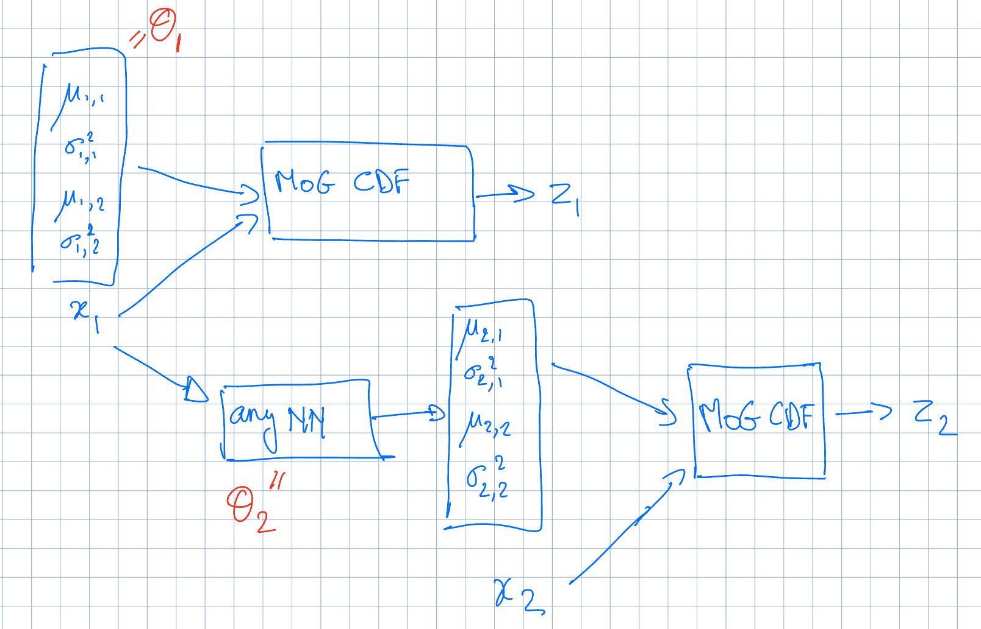
Example 2-D Autoregressive Flow

Slide 28
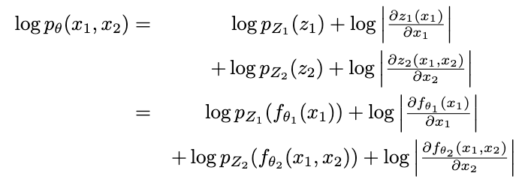
Training Objective

Slide 29
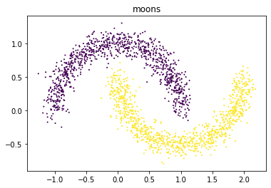
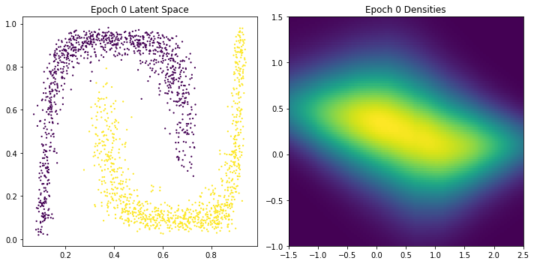
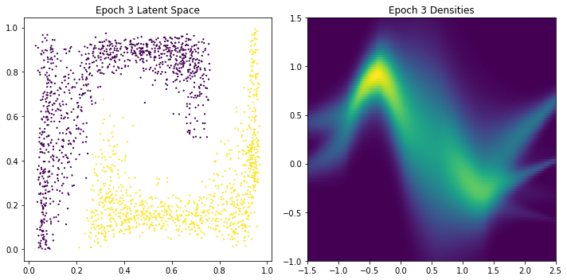
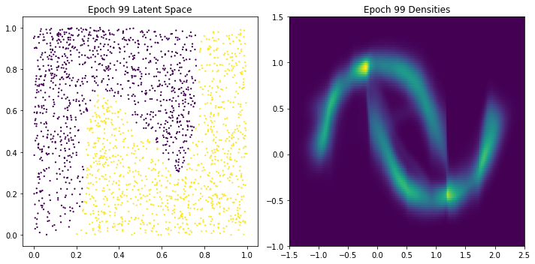
2-D Autoregressive Flow: Two Moons
Architecture:
Base distribution: Uniform[0,1]^2
x1: mixture of 5 Gaussians
i.e. z1 = cdf of Mo5G
x2: mixture of 5 Gaussians, conditioned on x1
I.e. z2 = cdf of Mo5G with mixture weights w, means mu, variances sigma conditioned on x1. I.e. arbitrary NN can be trained to map from x1 to w, mu, sigma
Notes:
X2 = modeled as NN that outputs 5 means and 5 log sigmas and then we optimize log likelihood; or, alternatively X2 = modeled as cumulative density that’s parameterized by a neural net that outputs 5 means and 5 log sigmas
Note this plot also shows why maybe embeddings aren’t great (gap between clusters is lost); also, suggests high derivatives at boundaries (kind of same point again)

Slide 30
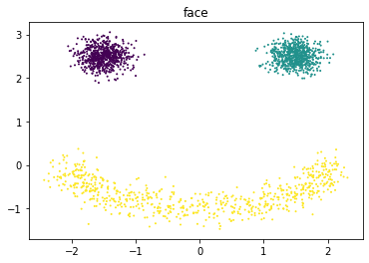
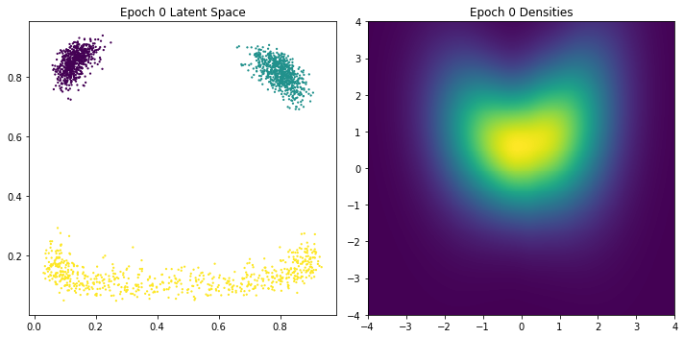
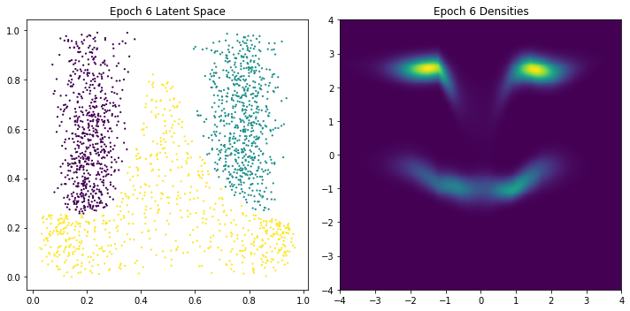
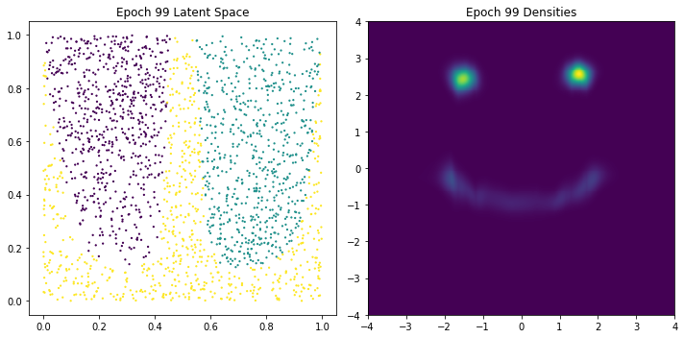
2-D Autoregressive Flow: Face
Architecture:
Base distribution: Uniform[0,1]^2
x1: mixture of 5 Gaussians
x2: mixture of 5 Gaussians, conditioned on x1

Slide 31
Outline
Foundations of Flows (1-D)
2-D Flows
N-D Flows
Dequantization

Slide 32
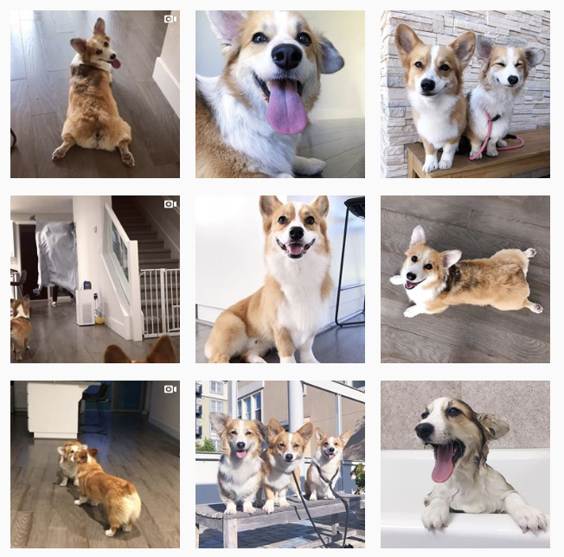
High-dimensional data
f (inference)
f⁻¹ (sampling)
x and z must have the same dimension

Slide 33
Outline
Foundations of Flows (1-D)
2-D Flows
N-D Flows
Autoregressive Flows and Inverse Autoregressive Flows
RealNVP (like) architectures
Glow, Flow++, FFJORD
Dequantization

Slide 34
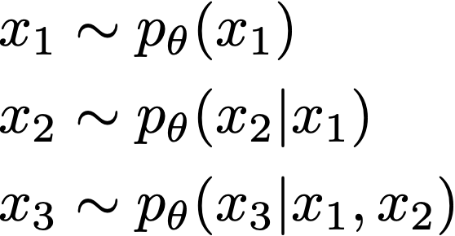
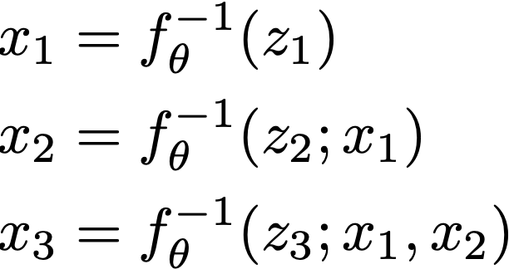
Autoregressive flows
The sampling process of a Bayes net is a flow
If autoregressive, this flow is called an autoregressive flow
Sampling is an invertible mapping from z to x
Notes:
%x_1 &\sim p_\theta(x_1) \\
%x_2 &\sim p_\theta(x_2 | x_1) \\
%x_3 &\sim p_\theta(x_3 | x_1, x_2) \\
x_1 &= f_\theta^{-1}(z_1) \\
x_2 &= f_\theta^{-1}(z_2; x_1) \\
x_3 &= f_\theta^{-1}(z_3; x_1, x_2) \\

Slide 35
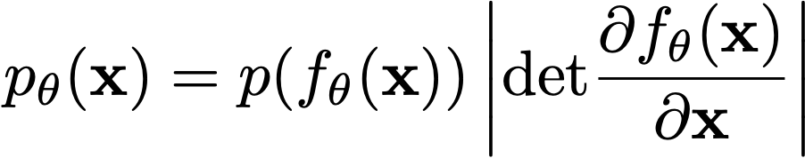
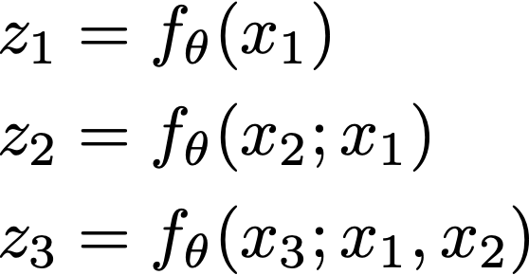
Autoregressive flows
How to fit autoregressive flows?
Map x to z
Fully parallelizable
Notice
x → z has the same structure as the log likelihood computation of an autoregressive model
z → x has the same structure as the sampling procedure of an autoregressive model
Notes:
z_1 &= f_\theta(x_1) \\
z_2 &= f_\theta(x_2; x_1) \\
z_3 &= f_\theta(x_3; x_1, x_2) \\

Slide 36
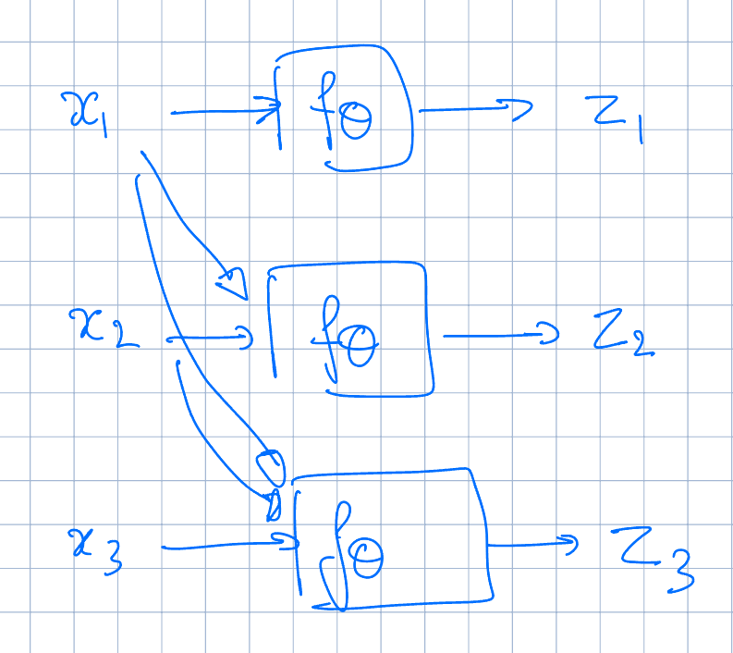
Autoregressive flows
Notes:
z_1 &= f_\theta(x_1) \\
z_2 &= f_\theta(x_2; x_1) \\
z_3 &= f_\theta(x_3; x_1, x_2) \\

Slide 37
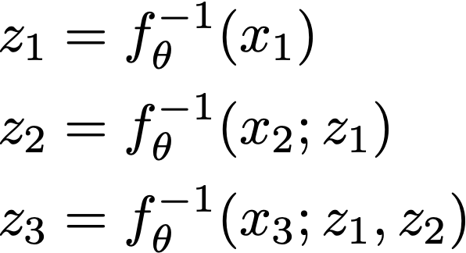
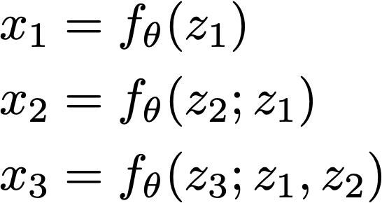
Inverse autoregressive flows
The inverse of an autoregressive flow is also a flow, called the inverse autoregressive flow (IAF)
x → z has the same structure as the sampling in an autoregressive model
z → x has the same structure as log likelihood computation of an autoregressive model. So, IAF sampling is fast

Slide 38
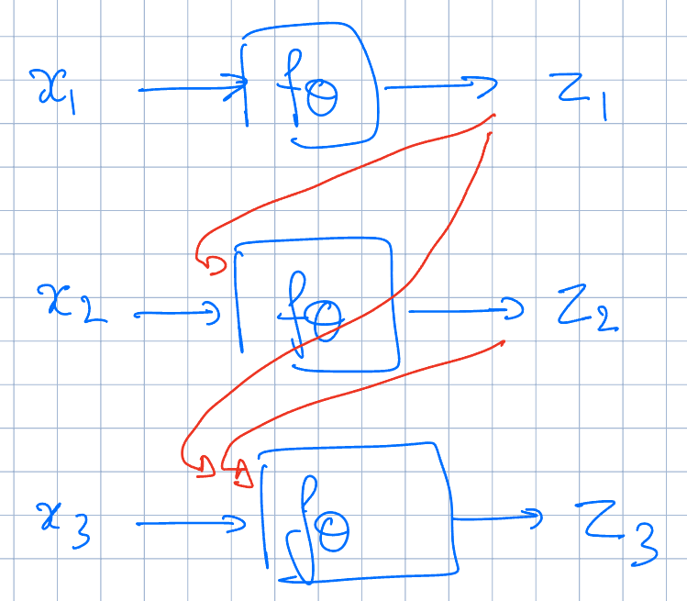
AF
IAF
Training: parallel / fast Sampling: long serial chain
Training: long serial chain Sampling: parallel / fast
Notes:
z_1 &= f_\theta(x_1) \\
z_2 &= f_\theta(x_2; x_1) \\
z_3 &= f_\theta(x_3; x_1, x_2) \\

Slide 39
AF vs IAF
Autoregressive flow
Fast evaluation of p(x) for arbitrary x
Slow sampling
Inverse autoregressive flow
Slow evaluation of p(x) for arbitrary x, so training directly by maximum likelihood is slow.
Fast sampling
Fast evaluation of p(x) if x is a sample
There are models (Parallel WaveNet, IAF-VAE) that exploit IAF’s fast sampling

Slide 40
Best of both AF and IAF
Key idea:
Train AF -> FAST
Distillation:
Sample from AF, keep activitations (bit slow..)
Train IAF on the samples using access to activations -> FAST

Slide 41
AF and IAF
Naively, both end up being as deep as the number of variables!
E.g. 1MP image → 1M layers…
Can do parameter sharing as in Autoregressive Models from lecture 2 [e.g. RNN, masking]

Slide 42
Outline
Foundations of Flows (1-D)
2-D Flows
N-D Flows
Autoregressive Flows and Inverse Autoregressive Flows
RealNVP (like) architectures
Glow, Flow++, FFJORD
Dequantization

Slide 43
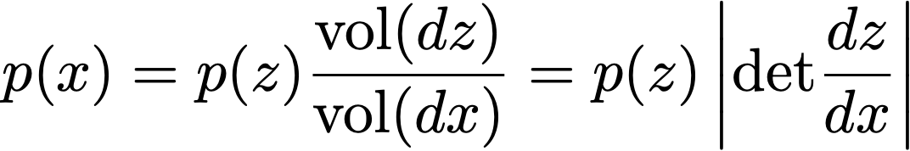
Change of MANY variables
For z ~ p(z), sampling process f⁻¹ linearly transforms a small cube dz to a small parallelepiped dx. Probability is conserved:
Intuition: x is likely if it maps to a “large” region in z space
Notes:
Prob(dx) = Prob(dz)
=> p(x)vol(dx) = p(z)vol(dz)
=> p(x) = p(z) vol(dz)/vol(dx) = p(z) |dz/dx|
p(x) &= p(z) \frac{\mathrm{vol}(dz)}{\mathrm{vol}(dx)} = p(z) \left|\mathrm{det}\frac{dz}{dx}\right|
Imagine diagonal matrix: product of volume changes along each axis aligned transformation dz/dx

Slide 44
Flow models: training
Change-of-variables formula lets us compute the density over x:
Train with maximum likelihood:
New key requirement: the Jacobian determinant must be easy to calculate and differentiate!
Notes:
p_\theta(\mathbf{x}) = p(f_\theta(\mathbf{x})) \left| \frac{\partial f_\theta(\mathbf{x})}{\partial \mathbf{x}} \right|
\arg\min_\theta \mathbb{E}_\mathbf{x} \left[ -\log p_\theta(\mathbf{x}) \right] = \mathbb{E}_\mathbf{x} \left[ -\log p(f_\theta(\mathbf{x})) - \log \mathrm{det} \left| \frac{\partial f_\theta(\mathbf{x})}{\partial \mathbf{x}} \right| \right]
Maximum likelihood objective KL(data || f^{-1}(z)) is equivalent to KL(f(data) || z) -- i.e. training by maximum likelihood tries to make the latents match the prior. This makes sense: if this happens, then samples will be good.

Slide 45
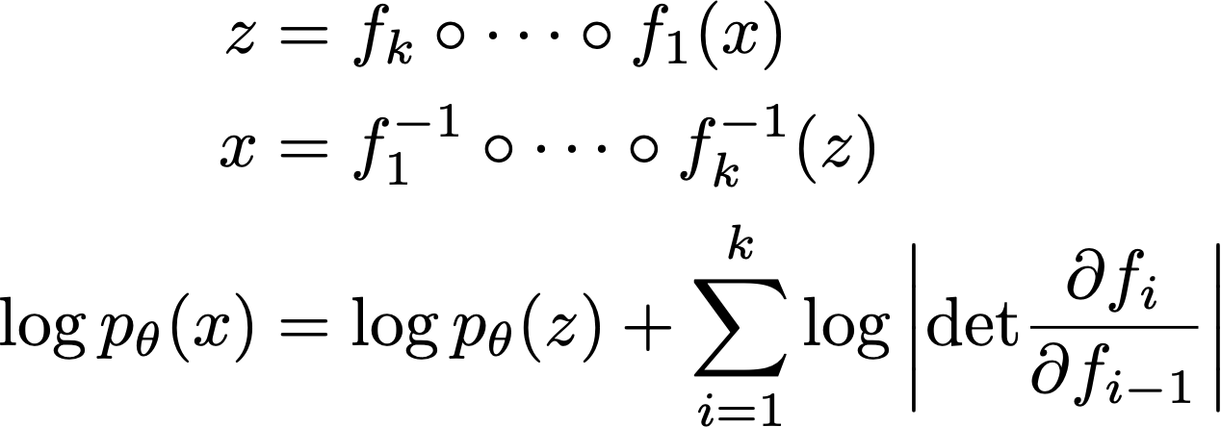
Constructing flows: composition
Flows can be composed
x → f₁ → f₂ → … f_{k} → z
Easy way to increase expressiveness
Notes:
Earlier we said flows let us fit continuous data -- a bonus over discrete models. But here’s a new bonus: we can compose flows. Not possible with discrete models.
z &= f_k \circ \cdots \circ f_1(x) \\
x &= f_1^{-1} \circ \cdots \circ f_k^{-1}(z) \\
\log p_\theta(x) &= \log p_\theta(z) + \sum_{i=1}^k\log \left| \mathrm{det} \frac{\partial f_i}{\partial f_{i-1}} \right|
This is an axis along which you can design models to increase power at a hopefully modest sampling time increase.
One layer of this autoregressive flow is actually limiting
Live demo of it failing to fit a mixture of 2d Gaussian. — it will not capture multi-modal distribution
Stacking autoregressive flows comes to rescue!
Core distinction from discrete autoregressive models: continuous ones can be stacked!
If f1, f2… are invertible, f1 . f2 . …. is also invertible!
Live demo showing that now stacked AF can solve mixture task

Slide 46
Affine flows
Another name for affine flow: multivariate Gaussian.
Parameters: an invertible matrix A and a vector b
f(x) = A⁻¹(x - b)
Sampling: x = Az + b, where z ~ N(0, I)
Log likelihood is expensive when dimension is large.
The Jacobian of f is A⁻¹
Log likelihood involves calculating det(A)

Slide 47
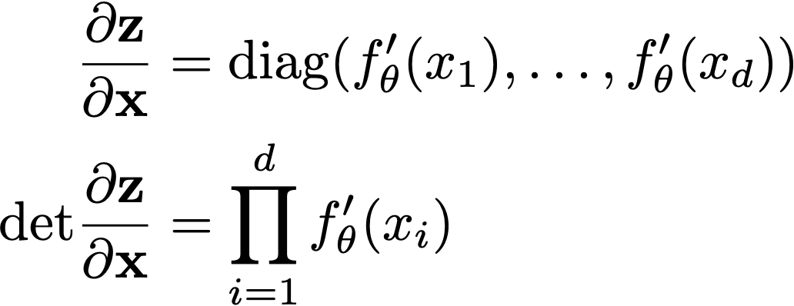
Elementwise flows
Lots of freedom in elementwise flow
Can use elementwise affine functions or CDF flows.
The Jacobian is diagonal, so the determinant is easy to evaluate.
Notes:
f_\theta((x_1, \dotsc, x_d)) = (f_\theta(x_1), \dotsc, f_\theta(x_d))
\frac{\partial \mathbf{z}}{\partial \mathbf{x}} &= \mathrm{diag}(f_\theta'(x_1), \dotsc, f_\theta'(x_d))\\
\mathrm{det} \frac{\partial \mathbf{z}}{\partial \mathbf{x}} &= \prod_{i=1}^d f_\theta'(x_i)

Slide 48
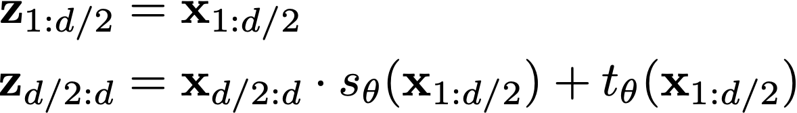
NICE/RealNVP
Affine coupling layer
Split variables in half: x_{1:d/2}, x_{d/2+1:d}
Invertible! Note that s_{θ} and t_{θ} can be arbitrary neural nets with no restrictions.
Think of them as data-parameterized elementwise flows.
Notes:
\mathbf{z}_{1:d/2} &= \mathbf{x}_{1:d/2} \\
\mathbf{z}_{d/2:d} &= \mathbf{x}_{d/2:d} \cdot s_\theta(\mathbf{x}_{1:d/2}) + t_\theta(\mathbf{x}_{1:d/2})
An explicit example of stacking weak flows: each flow is like a very weak Bayes net, in which half of the variables are conditionally independent given the other half
NICE/RealNVP
Feistel network

Slide 49


NICE/RealNVP
It also has a tractable Jacobian determinant
The Jacobian is triangular, so its determinant is the product of diagonal entries.
Notes:
\frac{\partial \mathbf{z}}{\partial \mathbf{x}} = \begin{bmatrix}
I &0 \\
\frac{\partial \mathbf{z}_{d/2:d}}{\partial \mathbf{x}_{1:d/2}} & \mathrm{diag}(s_\theta(\mathbf{x}_{1:d/2}))
\end{bmatrix}
\mathrm{det} \frac{\partial \mathbf{z}}{\partial \mathbf{x}} = \prod_{k=1}^d s_\theta(\mathbf{x}_{1:d/2})_k

Slide 50

RealNVP
Takeaway: coupling layers allow unrestricted neural nets to be used in flows, while preserving invertibility and tractability
[Dinh et al. Density estimation using Real NVP. ICLR 2017]

Slide 51
RealNVP Architecture
Input x: 32x32xc image
Layer 1: (Checkerboard x3, channel squeeze, channel x3)
Split result to get x1: 16x16x2c and z1: 16x16x2c (fine-grained latents)
Layer 2: (Checkerboard x3, channel squeeze, channel x3)
Split result to get x2: 8x8x4c and z2: 8x8x4c (coarser latents)
Layer 3: (Checkerboard x3, channel squeeze, channel x3)
Get z3: 4x4x16c (latents for highest-level details)

Slide 52

RealNVP: How to partition variables?

Slide 53


Good vs Bad Partitioning
Checkerboard x4; channel squeeze; channel x3; channel unsqueeze; checkerboard x3
(Mask top half; mask bottom half; mask left half; mask right half) x2

Slide 54
Outline
Foundations of Flows (1-D)
2-D Flows
N-D Flows
Autoregressive Flows and Inverse Autoregressive Flows
RealNVP (like) architectures
Glow, Flow++, FFJORD
Dequantization

Slide 55

Choice of coupling transformation
A Bayes net defines coupling dependency, but what invertible transformation f to use is a design question
Affine transformation is the most commonly used one (NICE, RealNVP, IAF-VAE, …)
More complex, nonlinear transformations -> better performance
CDFs and inverse CDFs for Mixture of Gaussians or Logistics (Flow++)
Piecewise linear/quadratic functions (Neural Importance Sampling)
Notes:
\bx_i = \bz_i \cdot \ba_\theta(\mathrm{parent}(\bx_i)) + \bb_\theta(\mathrm{parent}(\bx_i))

Slide 56

NN architecture also matters
Flow++ = MoL transformation + self-attention in NN
Bayes net (coupling dependency), transformation function class, NN architecture all play a role in a flow’s performance. Still an
Notes:
\bx_i = \bz_i \cdot \ba_\theta(\mathrm{parent}(\bx_i)) + \bb_\theta(\mathrm{parent}(\bx_i))

Slide 57

Other classes of flows
Glow (link)
Invertible 1x1 convolutions
Large-scale training
Continuous time flows (FFJORD)
Allows for unrestricted architectures. Invertibility and fast log probability computation guaranteed.

Slide 58

Glow: Interpolation

Slide 59

Glow: Attribute Control
Notes:
By looking at data w and without smile, take average embedding of each group, look at the difference, apply latent space change in that direction

Slide 60
Outline
Foundations of Flows (1-D)
2-D Flows
N-D Flows
Dequantization

Slide 61



Flow on Discrete Data Without Dequantization...

Slide 62


Continuous flows for discrete data
A problem arises when fitting continuous density models to discrete data: degeneracy
When the data are 3-bit pixel values,
What density does a model assign to values between bins like 0.4, 0.42…?
Correct semantics: we want the integral of probability density within a discrete interval to approximate discrete probability mass
Notes:
\bx \in \{0, 1, 2, \dotsc, 255\}
P_\mathrm{model}(\bx) \coloneqq \int_{[0,1)^D} p_\mathrm{model}(\bx + \bu) \, d\bu
Practically: + noise from U[-0.5, 0.5]

Slide 63


Continuous flows for discrete data
Solution: Dequantization. Add noise to data.
We draw noise u uniformly from
[Theis, Oord, Bethge, 2016]
Notes:
\Eb{\by \sim p_\mathrm{data}}{\log p_\mathrm{model}(\by)}
&= \sum_{\bx} P_\mathrm{data}(\bx) \int_{[0,1)^D} \log p_\mathrm{model}(\bx + \bu) \, d\bu \\
&\leq \sum_{\bx} P_\mathrm{data}(\bx) \log \int_{[0,1)^D} p_\mathrm{model}(\bx + \bu) \, d\bu \\
&= \Eb{\bx \sim P_\mathrm{data}} {\log P_\mathrm{model}(\bx)}

Slide 64



Flow on Discrete Data With Dequantization

Slide 65
Future directions
The ultimate goal: a likelihood-based model with
fast sampling
fast inference
fast training
good samples
good compression
Flows seem to let us achieve some of these criteria.
But how exactly do we design and compose flows for great performance? That’s an open question.
Some requirements that might pose permanent challenges:
Dimensionality preserving
Invertibility
Cheap determinant

Slide 66
Bibliography
NICE: Dinh, Laurent, David Krueger, and Yoshua Bengio. "NICE: Non-linear independent components estimation." arXiv preprint arXiv:1410.8516 (2014).
RealNVP: Dinh, Laurent, Jascha Sohl-Dickstein, and Samy Bengio. "Density estimation using Real NVP." arXiv preprint arXiv:1605.08803 (2016).
AF: Chen, Xi, et al. "Variational lossy autoencoder." arXiv preprint arXiv:1611.02731 (2016).;
Masked autoregressive flow for density estimation, Papamakarios, George, Theo Pavlakou, and Iain Murray. Advances in Neural Information Processing Systems. 2017.
IAF: Improved variational inference with inverse autoregressive flow. Kingma, Durk P., et al. Advances in neural information processing systems. 2016.
Neural Importance Sampling: Müller, Thomas, et al. arXiv preprint arXiv:1808.03
Glow: Kingma, Durk P., and Prafulla Dhariwal. "Glow: Generative flow with invertible 1x1 convolutions." Advances in Neural Information Processing Systems. 2018.
FFJORD: Grathwohl, Will, et al. "Ffjord: Free-form continuous dynamics for scalable reversible generative models." arXiv preprint arXiv:1810.01367 (2018).
Neural Autoregressive Flow: Huang, Chin-Wei, et al. arXiv:1804.00779 (2018)
Residual Flows for invertible generative modeling, Ricky T. Q. Chen, Jens Behrmann, David Duvenaud, Jörn-Henrik Jacobsen, arXiv: 1906.02735
Flow++: Improving Flow-Based Generative Models with Variational Dequantization and Architecture Design. Ho, Jonathan, Chen, Srinivas, Duan, Abbeel ICML 2019, arXiv:1902.00275 (2019).
MintNet: Building Invertible Neural Networks with Masked Convolutions, Song, Meng, Ermon, NeurIPS 2019, arXiv: 1907.07945
Normalizing Flows for Probabilistic Modeling and Inference, George Papamakarios, Eric Nalisnick, Danilo Jimenez Rezende, Shakir Mohamed, Balaji Lakshminarayanan https://arxiv.org/abs/1912.02762, JMLR [survey/tutorial]
Normalizing Flows: An Introduction and Review of Methods, Ivan Kobyzev, Simon JD Prince, Marcus A Brubaker, IEEE PAMI 2021 [survey/tutorial]

